Slide 1


NiceSched: memory access locality aware dynamic nice scheduling in tiered memory
Song, binwon

Slide 2
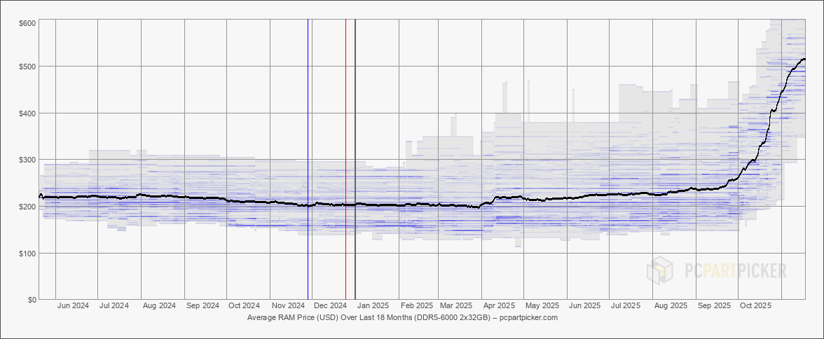
Background
Memory consumption
DDR5-6000 2x32GB average price in USD over last 18 month
Todays, about up to 2.5x increase DRAM price
Total cost of datacenter depends on memory (33%)
https://pcpartpicker.com/trends/price/memory/

Slide 3

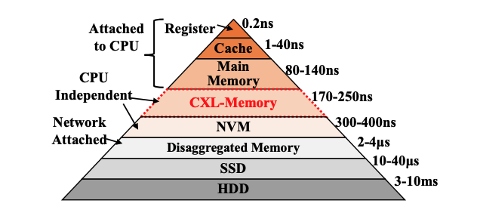
Background
Memory consumption
Compute express link (CXL) is emerged for decreasing total cost of ownership (TCO)
TPP, samsung

Slide 4
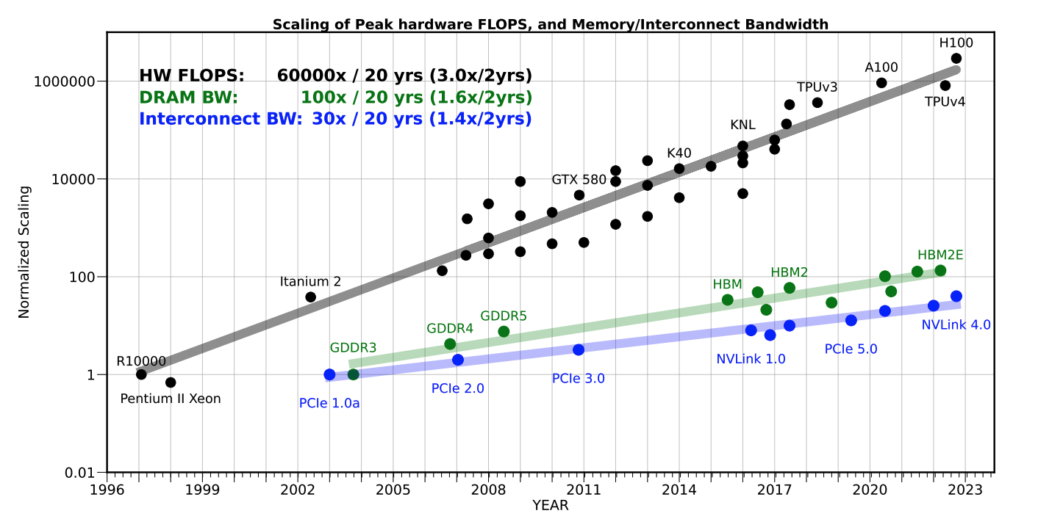
Background
Memory wall
CXL is also have same challenge
Consider memory bandwidth and latency
Amir Gholami et al. 2024. AI and Memory Wall. IEEE Micro

Slide 5
Motivation
Prior works
High-tier
HOT/ COLD
Page migration
Low-tier

Slide 6
Motivation
Prior works
Monitoring techniques
Prior work | Page fault | HW-event | PTE-scan | Default page size | Recency | Accuracy
TPP | O | X | X | Base page | Low | Low
MEMTIS | X | O | X | Huge page | Medium | Medium
M5 | X | O | X | Base page | High | High
FlexMem | O | O | X | Huge page | Medium | Medium
ADT | X | X | O | Base page | Medium | Low

Slide 7
Background
Challenges
HW-event
As many as page to be monitored, monitoring overhead is also increase
Both CPU attached and CXL attached not stable and attach all HW vendor
Monitoring techniques
Prior work | Page fault | HW-event | PTE-scan | Default page size | Recency | Accuracy
TPP | O | X | X | Base page | Low | Low
MEMTIS | X | O | X | Huge page | Medium | Medium
M5 | X | O | X | Base page | High | High
FlexMem | O | O | X | Huge page | Medium | Medium
ADT | X | X | O | Base page | Medium | Low

Slide 8
Background
Challenges
Page fault: known as high overhead but it is default policy It combines with AutoNUMA
Prior work | Page fault | HW-event | PTE-scan | Default page size | Recency | Accuracy
TPP | O | X | X | Base page | Low | Low
MEMTIS | X | O | X | Huge page | Medium | Medium
M5 | X | O | X | Base page | High | High
FlexMem | O | O | X | Huge page | Medium | Medium
ADT | X | X | O | Base page | Medium | Low

Slide 9
Background
Challenges
PTE-scan: hard to decide monitoring frequency
Prior work | Page fault | HW-event | PTE-scan | Default page size | Recency | Accuracy
TPP | O | X | X | Base page | Low | Low
MEMTIS | X | O | X | Huge page | Medium | Medium
M5 | X | O | X | Base page | High | High
FlexMem | O | O | X | Huge page | Medium | Medium
ADT | X | X | O | Base page | Medium | Low

Slide 10
Motivation
Challenges
If use Huge page, emerged “Hot Bloat” Issue
Unbalance in huge page leads to performance decrease
Huge Page
“HOT BLOAT”
Notes:
Pictures in prior work shows The huge page as Hot page

Slide 11
Motivation
Challenges
HW-event : stability, high accuracy
Page fault: high overhead, portability
PTE-scan: non-deterministic, medium accuracy
Prior work | Page fault | HW-event | PTE-scan | Default page size | Recency | Accuracy
TPP | O | X | X | Base page | Low | Low
MEMTIS | X | O | X | Huge page | Medium | Medium
M5 | X | O | X | Base page | High | High
FlexMem | O | O | X | Huge page | Medium | Medium
ADT | X | X | O | Base page | Medium | Low

Slide 12
Motivation
Challenges
Prior work | Page fault | HW-event | PTE-scan | Default page size | Recency | Accuracy
TPP | O | X | X | Base page | Low | Low
MEMTIS | X | O | X | Huge page | Medium | Medium
M5 | X | O | X | Base page | High | High
FlexMem | O | O | X | Huge page | Medium | Medium
ADT | X | X | O | Base page | Medium | Low
page migration and categorizing into HOT/COLD causes overhead
“No one is winner”
Other Approach needed

Slide 13
Motivation
How to resolve this problem without migration?
Scheduling is the Key!

Slide 14
Objective
Goal from prior works
Existing prior work focus on reducing remote access
Leverage high tier memory efficiently
Reduce monitoring overhead
Scheduling Mechanism
Employs NICE priority to steer CPU time
Maximize high tier memory utilization
With Scheduling, No migration and No additional monitoring
왜 스케줄링?
Focus on only Memory
But we focus on CPU as well

Slide 15
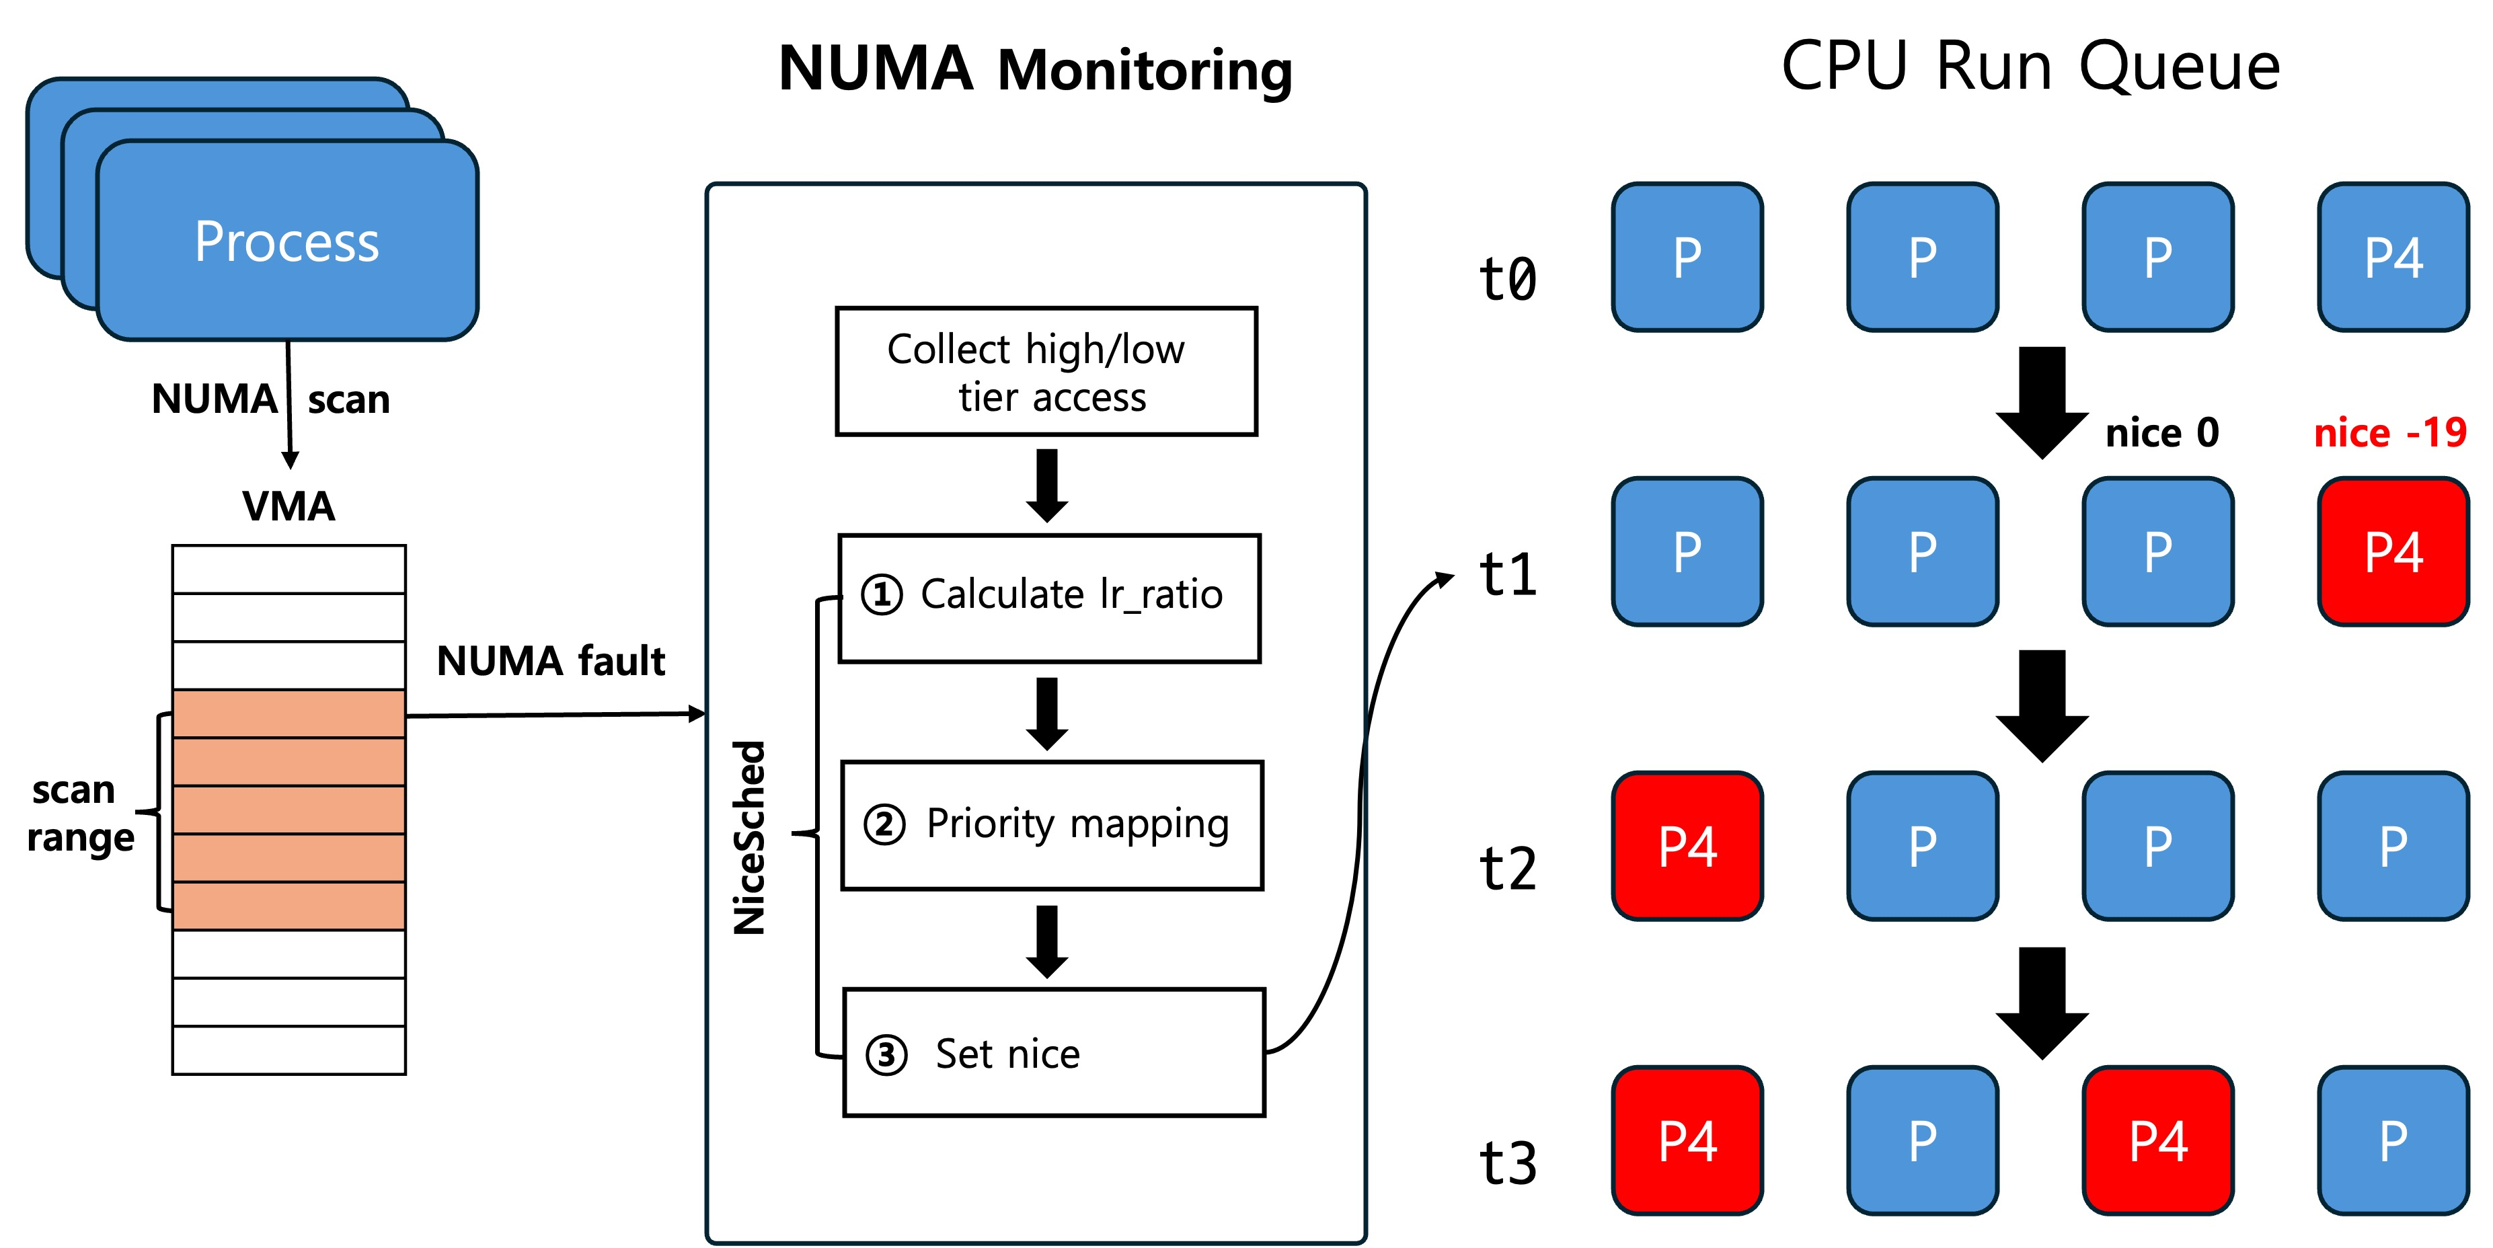
NiceSched
Design

Slide 16
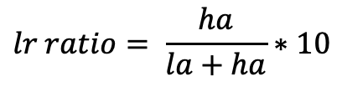
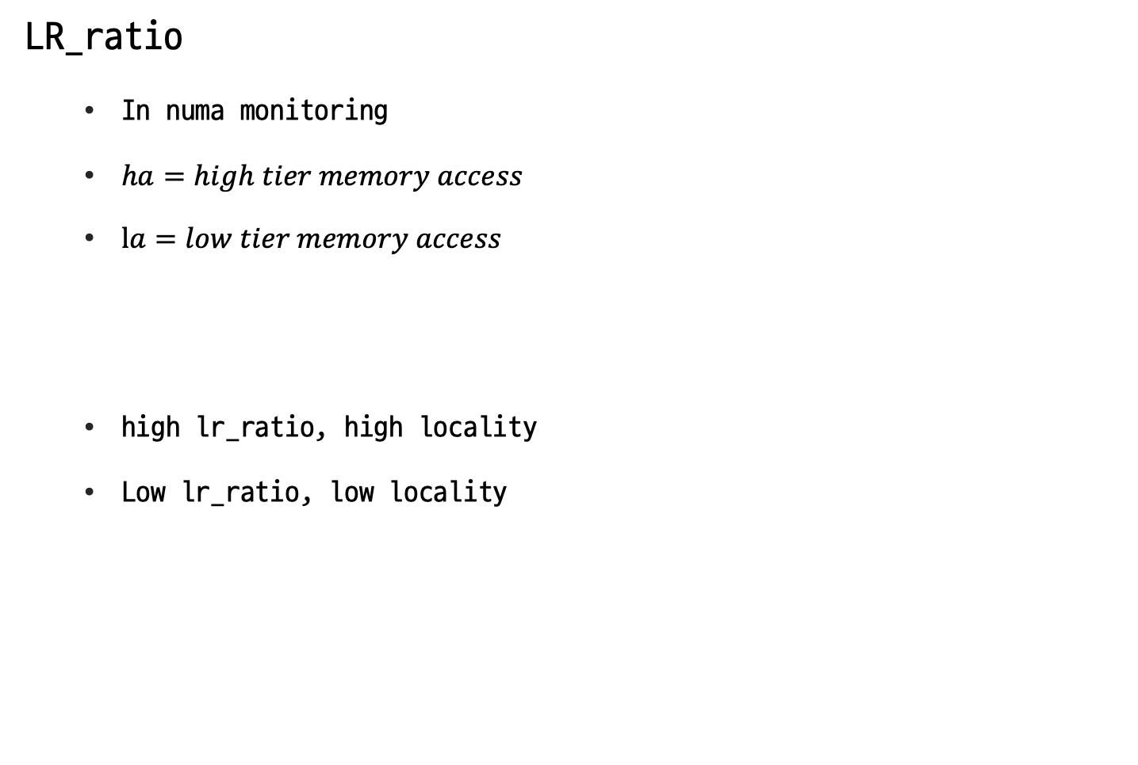
NiceSched
LR_ratio
In numa monitoring
$ha=high tier memory access$
$la=low tier memory access$
high lr_ratio, high locality
Low lr_ratio, low locality
$$lr ratio= \frac{ha}{la+ha}∗10$$

Slide 17
NiceSched
LR_ratio
High-tier memory
P4
High-tier
access
Low-tier memory
lr_ratio

Slide 18
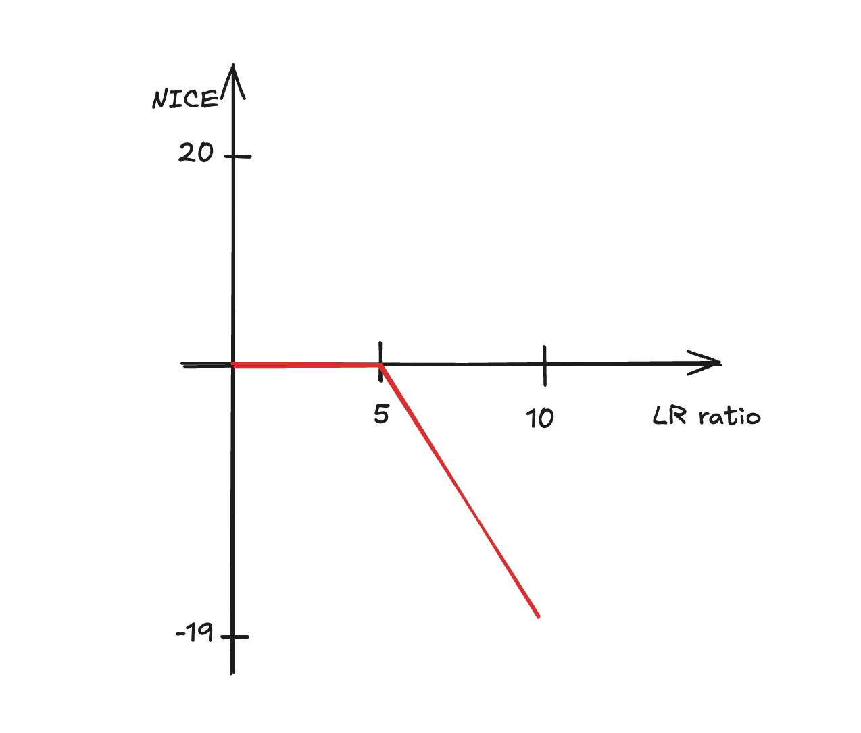
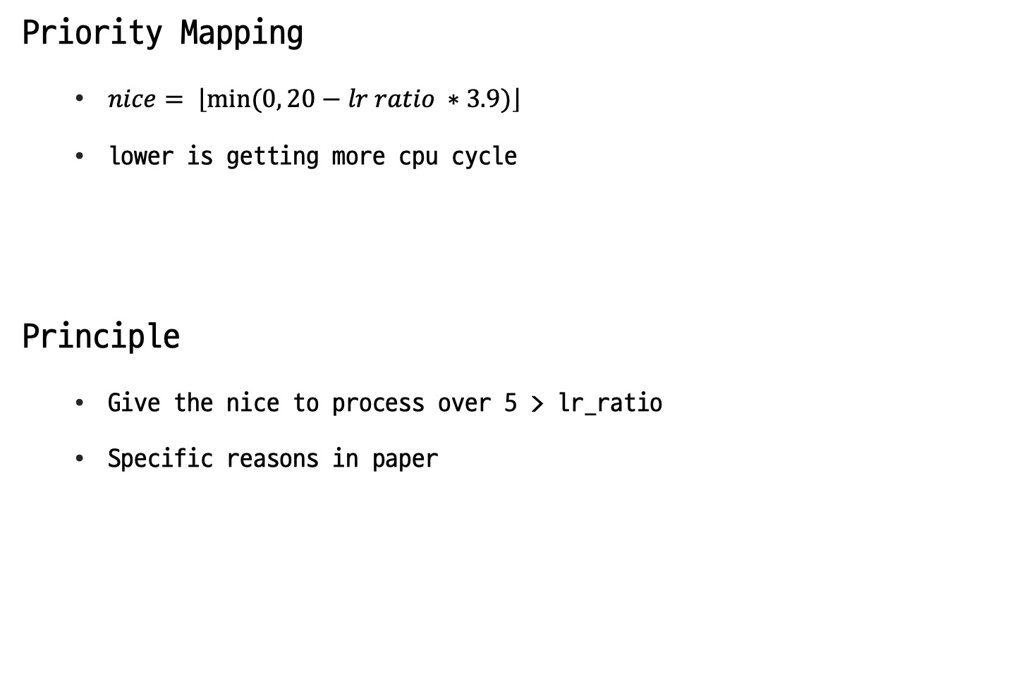
NiceSched
Priority Mapping
$nice= \left\lfloor min⁡(0, 20−lr ratio ∗3.9)\right\rfloor$
lower is getting more cpu cycle
Principle
Give the nice to process over 5 > lr_ratio
Specific reasons in paper

Slide 19
NiceSched
Dynamic Nice Adjustment
Every numa monitoring check and adjusting

Slide 20
NiceSched
How to Effect to System
Priority mapping
&
Set NICE

Slide 21
NiceSched
How to Effect to System
Reflect nice value
to scheduling

Slide 22
NiceSched
How to Effect to System
Getting more CPU cycle

Slide 23
NiceSched
Effect on the system
Priority mapping
&
Set NICE
Reflect nice value
to scheduling
Getting more CPU cycle

Slide 24
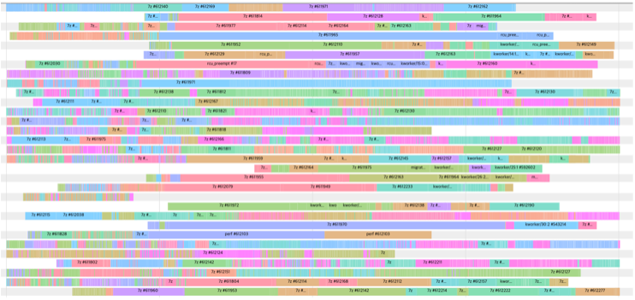
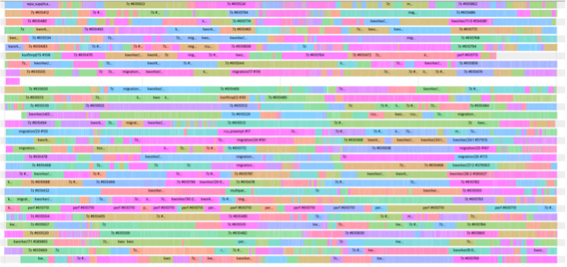
NiceSched
How to Effect to System
CPU cycle time
#CPU
w/o nice
w/ nice

Slide 25
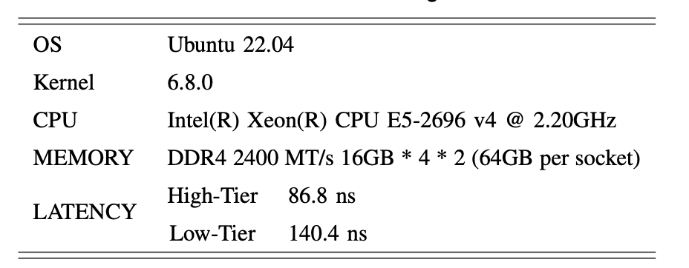
Evaluation
Setup
Simulating a tiered memory environment Turning off CPU on node 1
We evaluate increasing memory ratio of high tier to low tier

Slide 26
Evaluation
Criteria
Can it perform under varying high-tier to low-tier memory ratio?
How effective is the scheduling adjustment?
How many low-tier memory accesses are reduced?

Slide 27
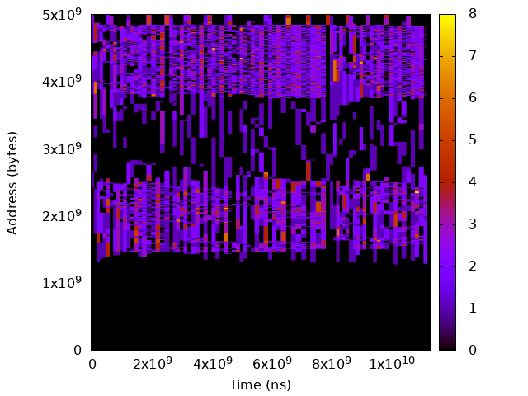
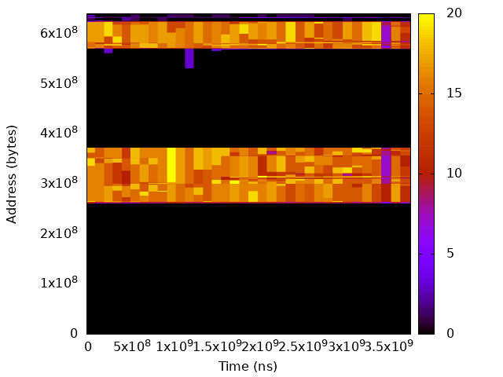
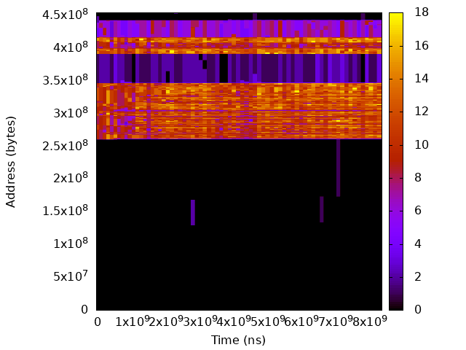
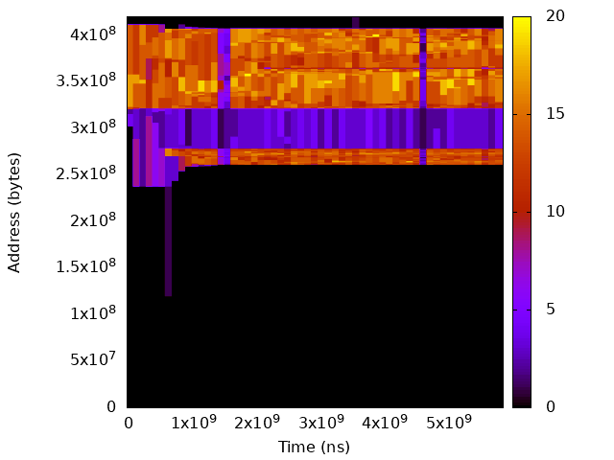
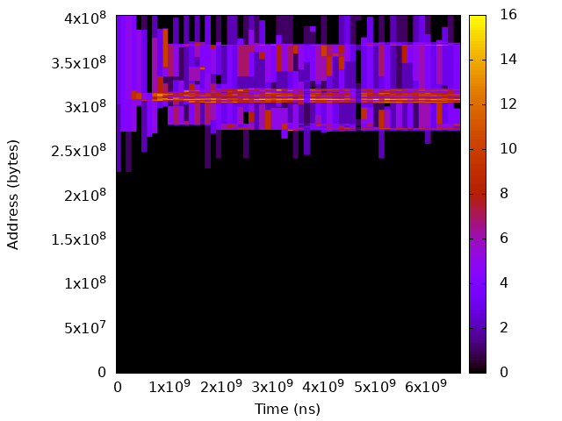
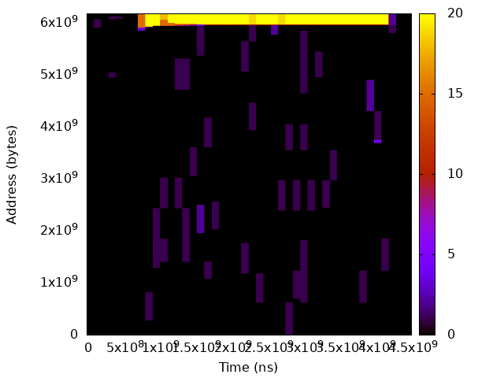
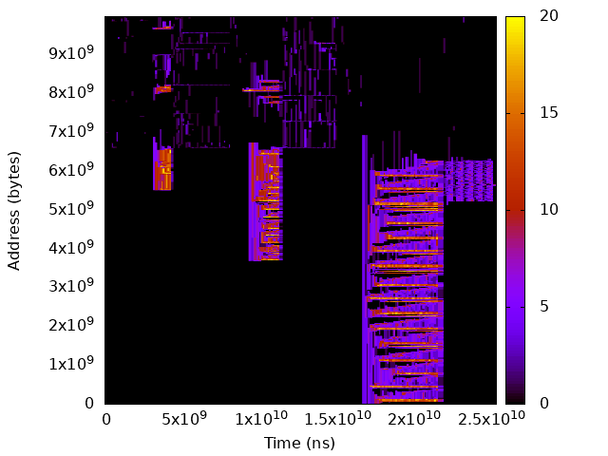
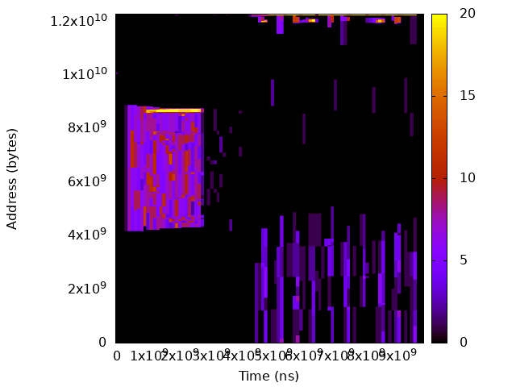
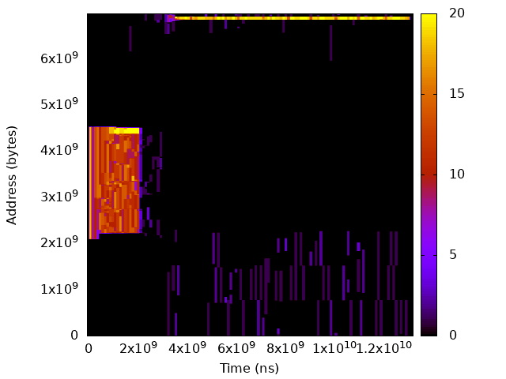
Evaluation

Slide 28
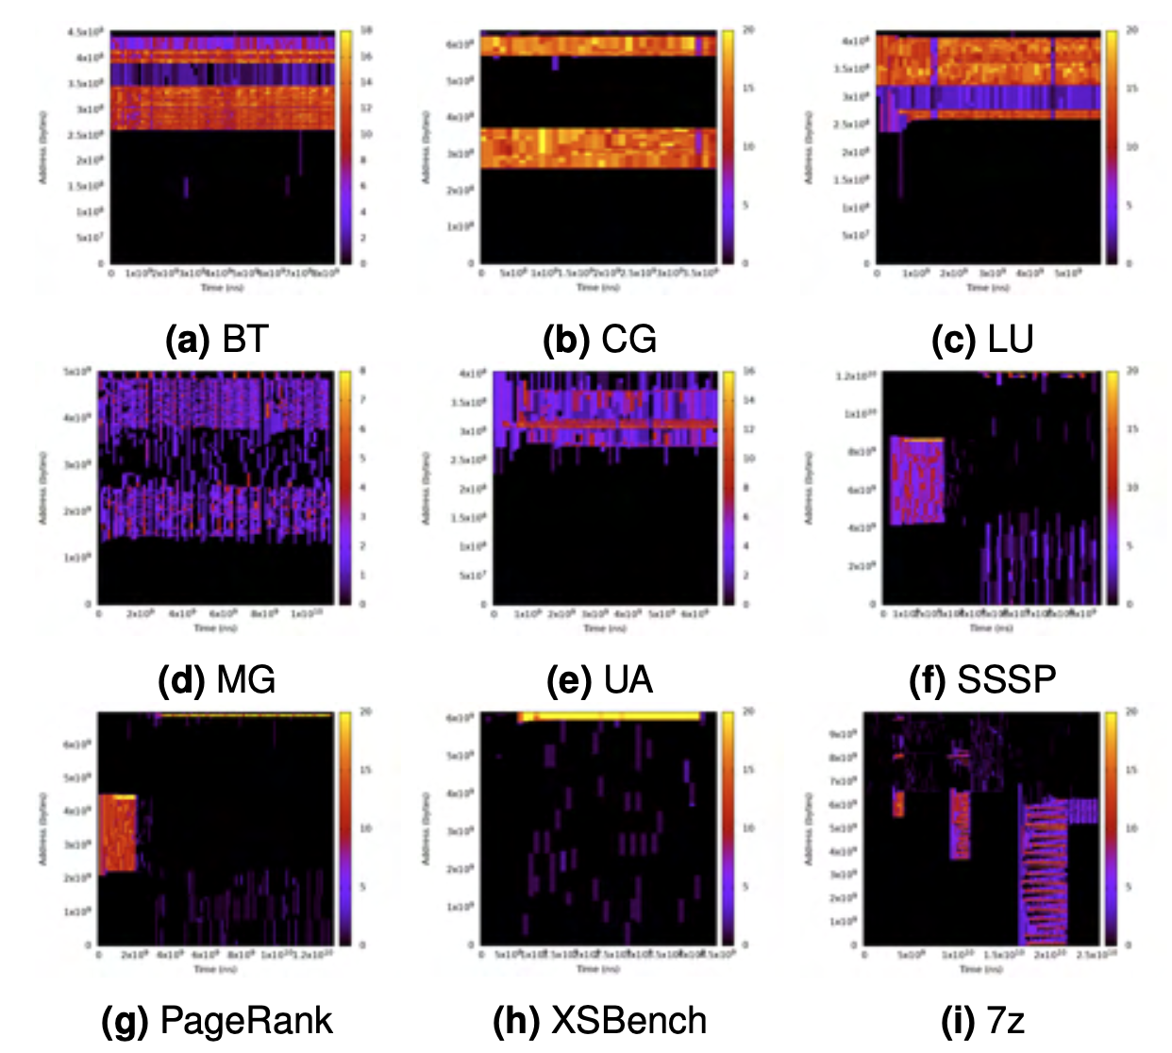
Evaluation
Workloads
NPB: MG, CG, BT, LT, UA (memory + CPU intensive)
XSBench, 7zip
Graph Processing: SSSP, Page Rank

Slide 29
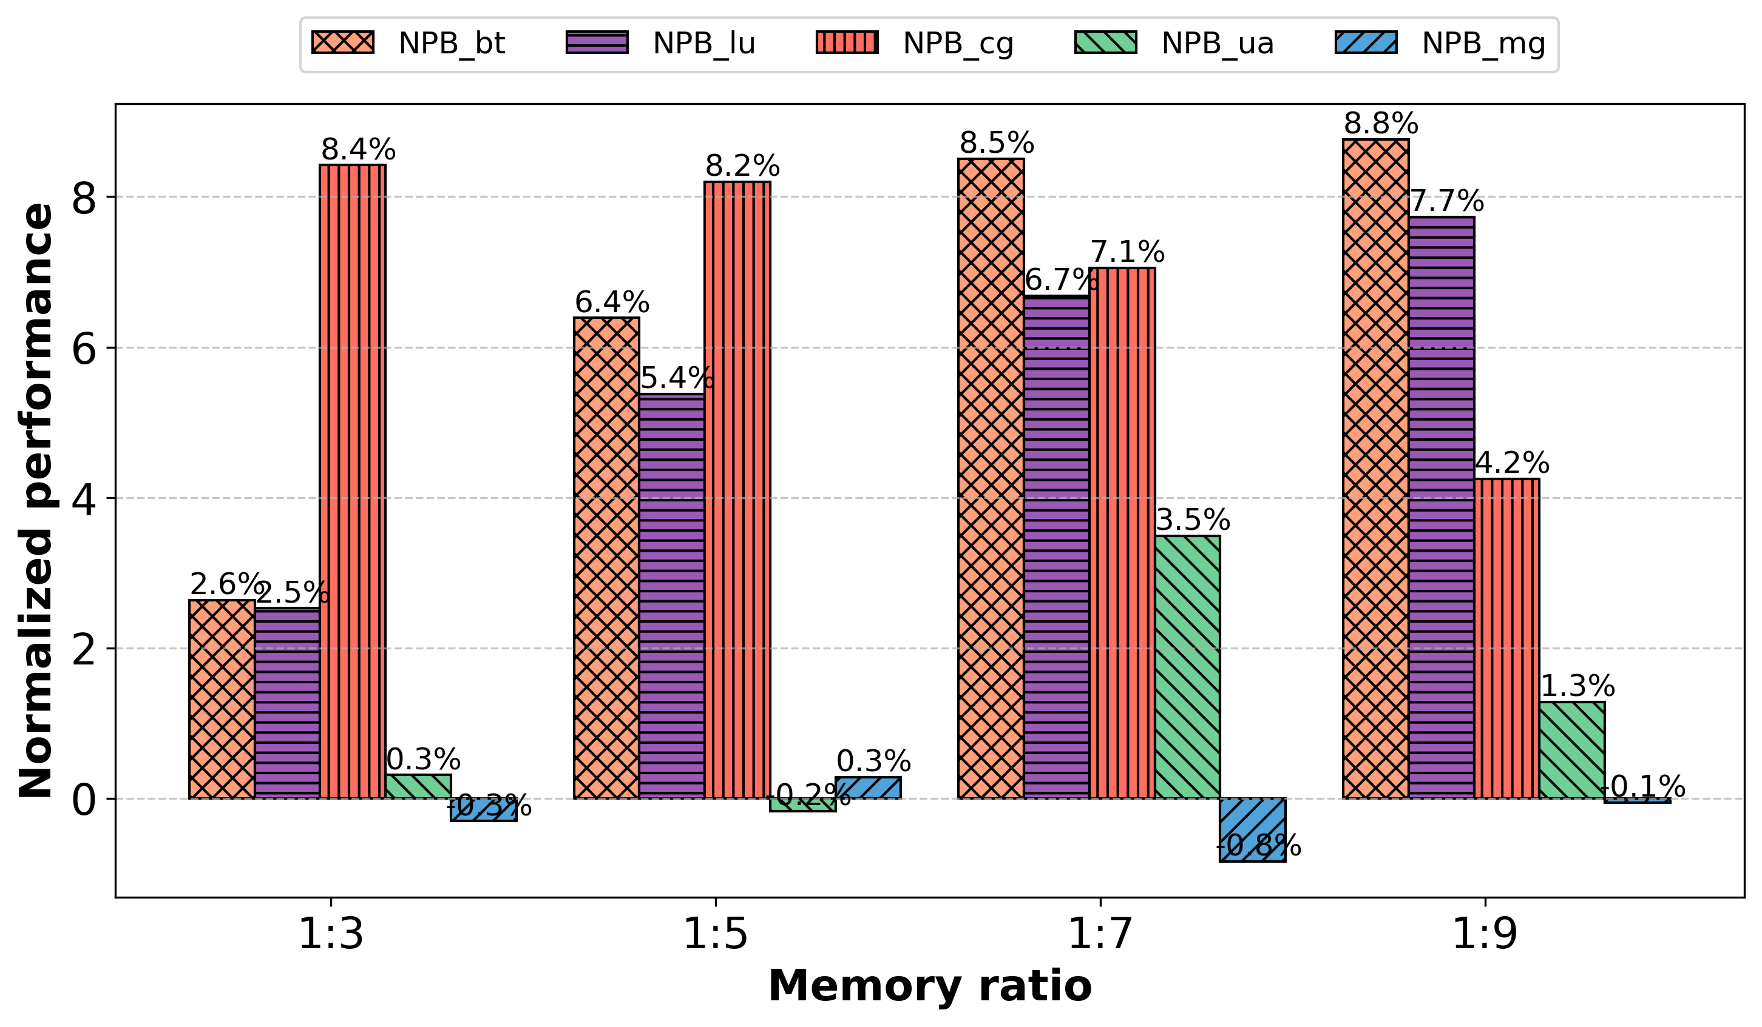
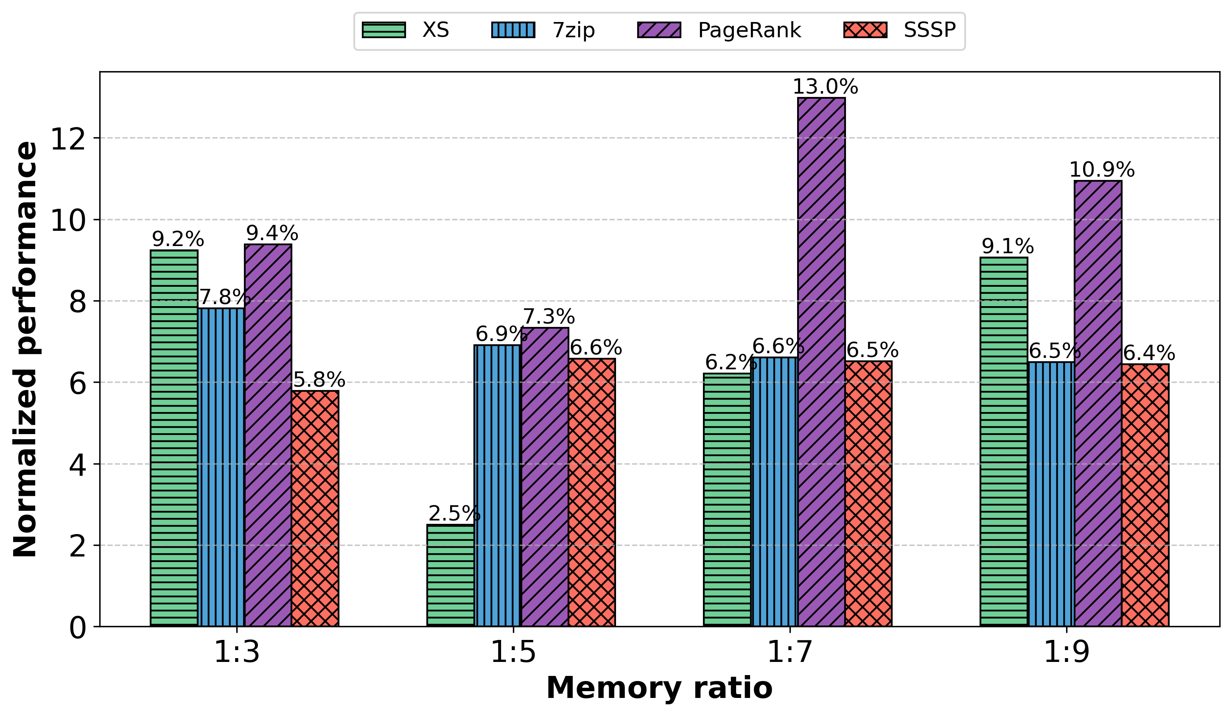
Evaluation
UP to 13% improvement
Due to reduce remote access
UP to <1% decrease
Due to no benefit leading overhead

Slide 30
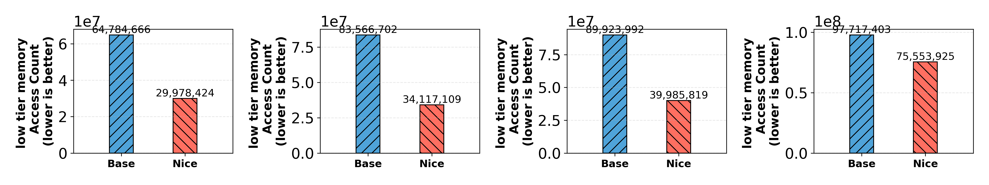
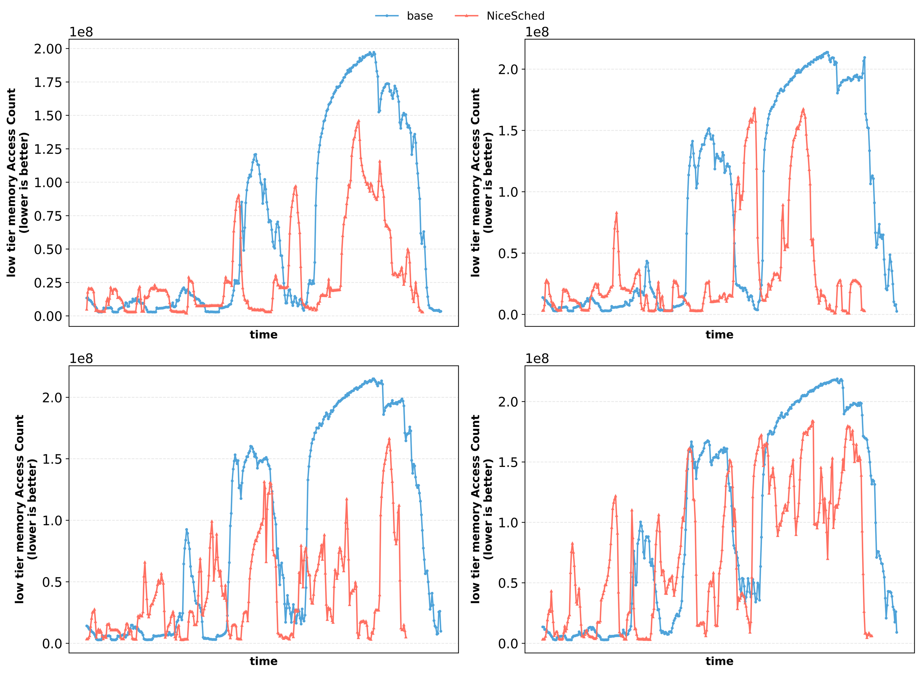
Evaluation
7z 위의 그림을 시간 순으로
높이가 낮아진다.
그림 하나만
Efficiently reduce
Low tier memory access
Efficiently leverage
High tier memory

Slide 31
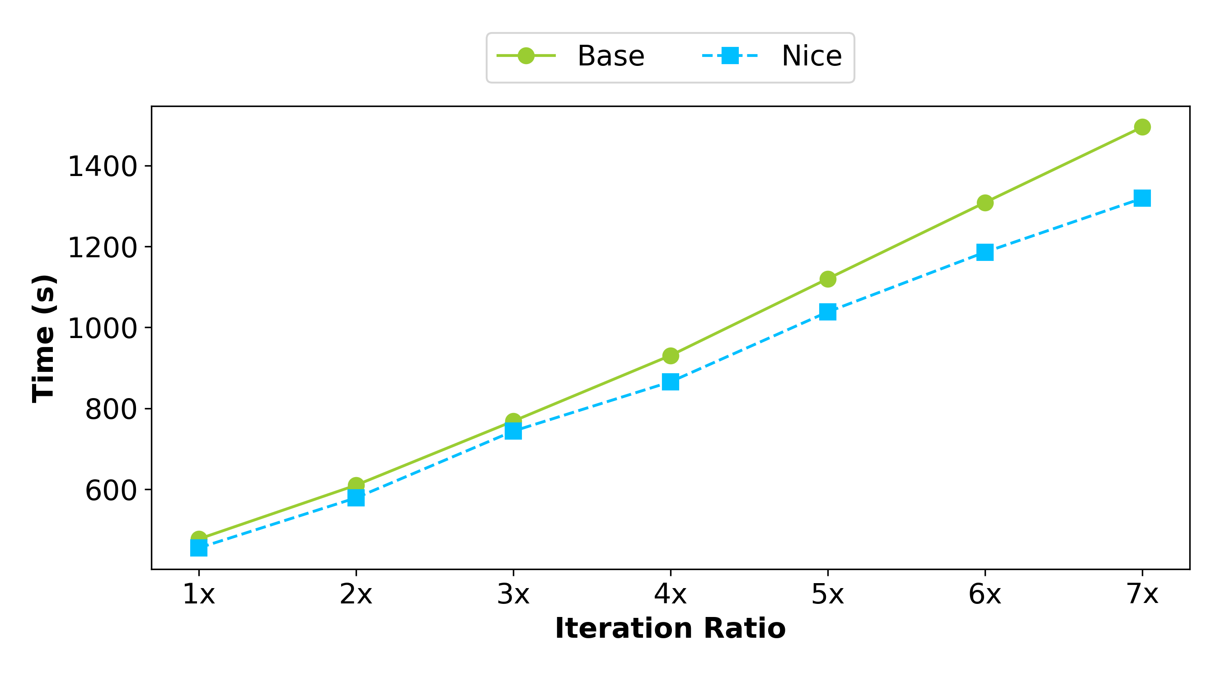
Evaluation
Runtime effect
Over time, leading to noticeable performance improvements.
워크로드 PR 돌린거
ㅊ퉤

Slide 32
Close up
Summary
Proposing new approach of tiered memory system
Without page migration and categorizing hot/cold
Efficiently reduce low tier memory access
Efficiently leverage high tier memory
Limitation
Without comparison prior work
No real HW evaluation
Restriction evaluation set up

Slide 33
Close up
Future work
Combining prior work method
E.g. Memtis + NiceSched
Multi-tier hierarchies support

Slide 34
QnA

